Slide 1
Monitoring and Debugging
Tools and diligence
Ralph Squillace

Slide 2


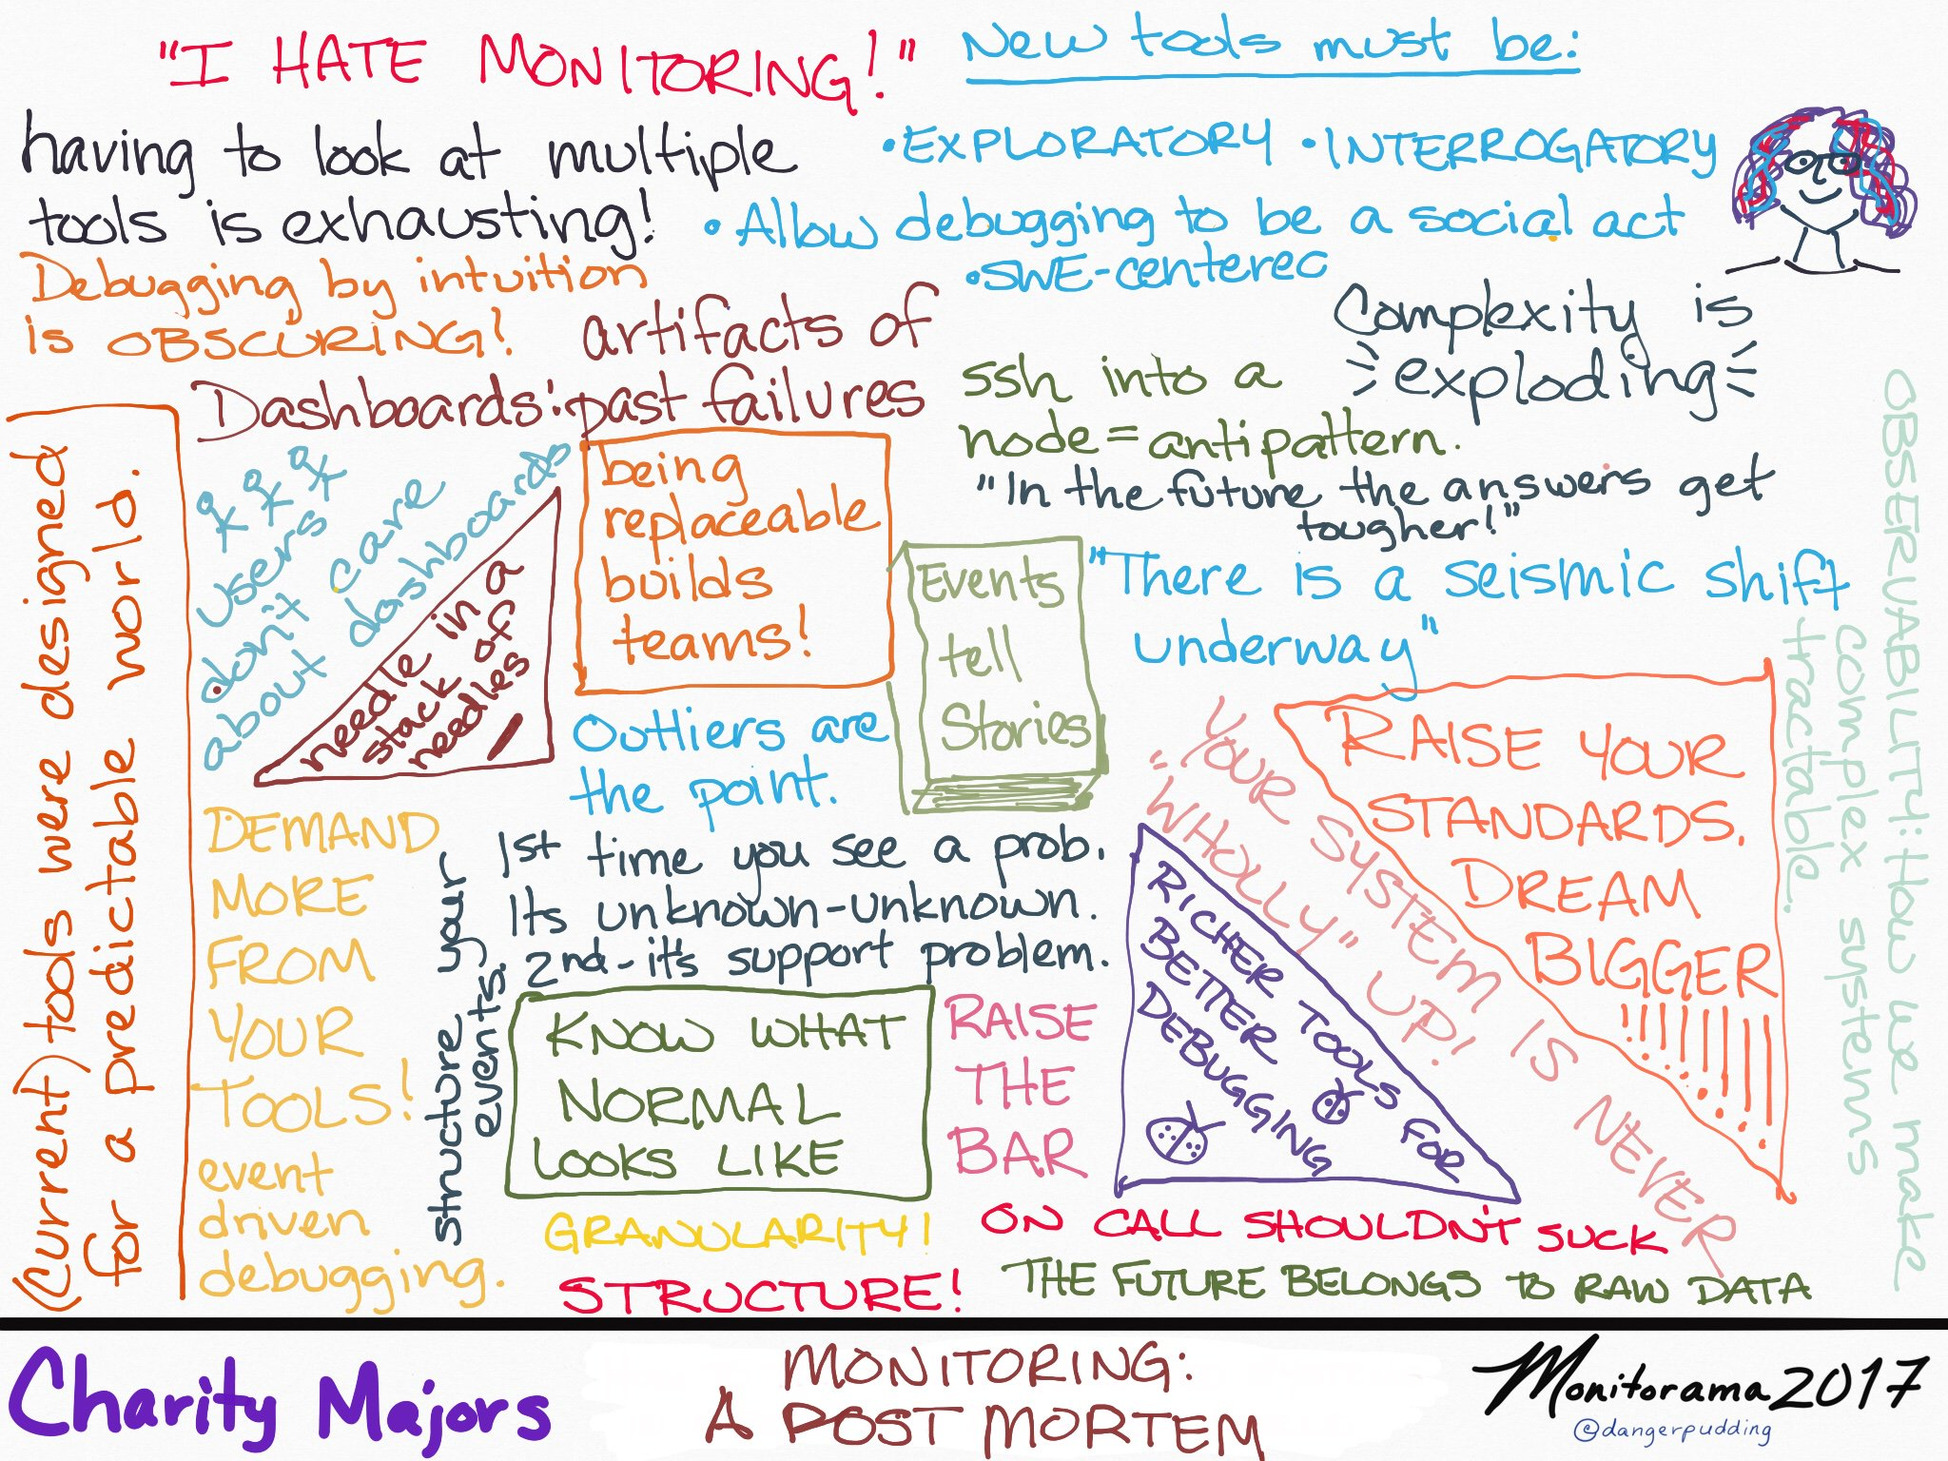



https://twitter.com/dangerpudding/status/866818886515032066/photo/1

